Slide 1
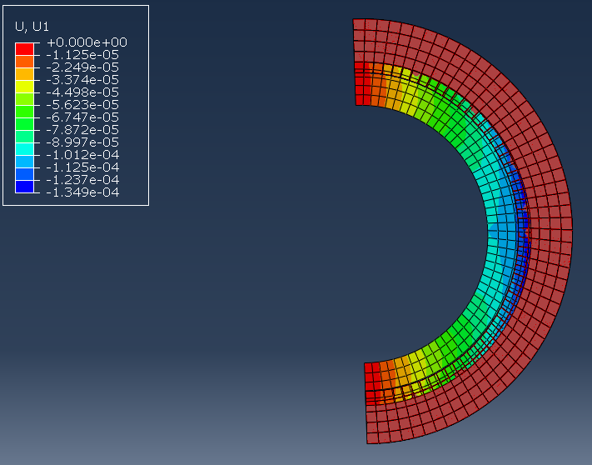
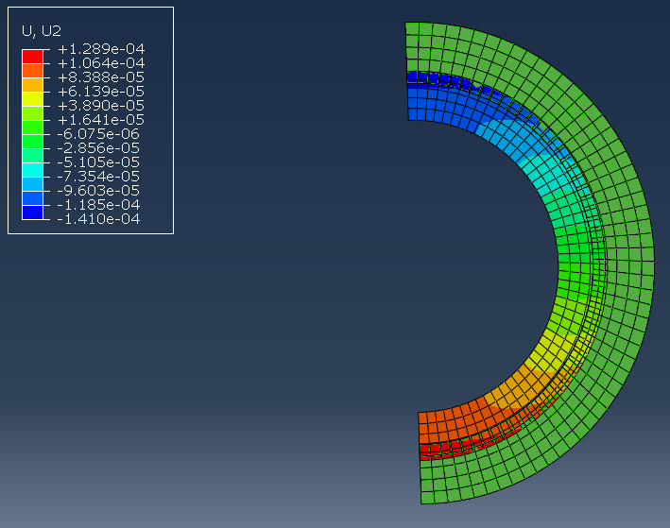
Deflection as result of Cryo cooling process (25C->-182C)
Simple 2D approximation of Ring:
2” Diameter
0.125” thickness
Boundary Conditions:
Symmetry x restrictions
All rotation restricted
Maximum x Deflection: ~-0.01374 inches
Maximum y Deflection: ~-0.0056 inches

Slide 2
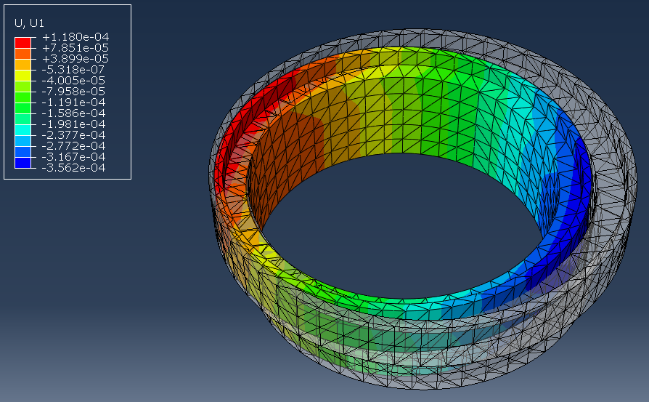
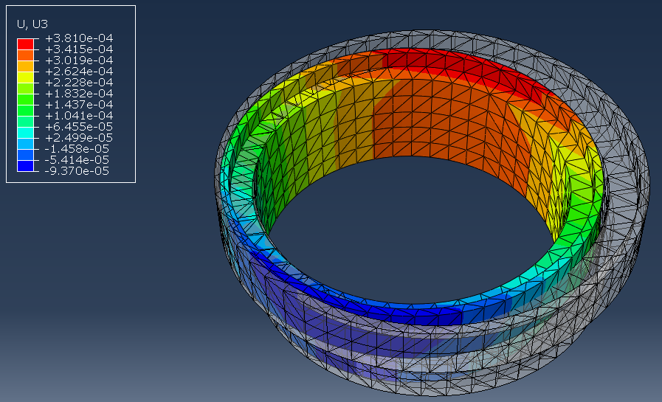
Deflection as result of Cryo Cooling process (25C->-182C)
6061-T6 Aluminum
Boundary Conditions: Restricted Vertical (y) movement, Restricted all rotation
X Direction Maximum Deflection: ~-0.014 inches
Z Direction Maximum Deflection: ~ -0.015 inches

